Slide 1


CANDY DISTRIBUTION ANALYSIS REPORT
By
Dharmesh Rohit
Data Analyst

Slide 2
Candy Distribution
Project Repository
Dataset: Maven Analytics
The Candy Distributor project focuses on analyzing nationwide sales performance and the logistical flow of candy products from factories to customers across the United States. The company operates through multiple production facilities, a wide range of candy products, and a large customer base spread across different states.
The business objective is to uncover strategic insights that will drive growth, optimize product strategy, improve regional targeting, and measure performance against sales goals.

Slide 3
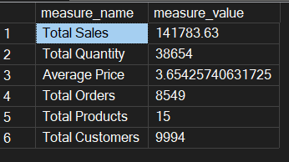
Exploratory Data Analysis
Date range of the data: "2021-01-03 “ to "2024-12-30“
The Candy Distributor has generated over $140K in total sales from nearly 39K units sold, spread across 15 unique products. With nearly 10K customers and an average unit price of $3.65, the business maintains a healthy order volume (8,549 orders)—indicating a high frequency of small-to-medium purchases, which aligns with the consumer nature of the candy industry.

Slide 4
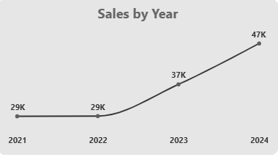
Sales Trend by Year (2021–2024)
The company’s sales growth trajectory has been upward, with significant momentum beginning in 2023.
2021 & 2022: Sales remained flat at 29K, suggesting a period of stabilization or stagnant demand.
2023: Sales increased sharply to 37K, marking a ~28% YoY growth—a sign of improved marketing, customer reach, or distribution.
2024: Continued this momentum, reaching 47K in sales—~27% growth from the previous year.

Slide 5
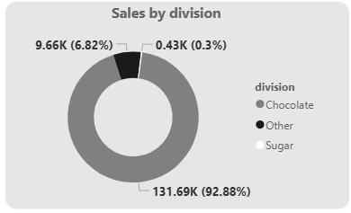
Sales by Product Division
The sales distribution is heavily concentrated in the Chocolate division, which accounts for an overwhelming 92.88% of total sales (131.69K out of 141.78K).
Sugar products contribute just 6.82% (9.66K) of sales, while
Other divisions are nearly negligible at 0.3% (0.43K).

Slide 6
Implications:
The dominance of chocolate suggests it is the core revenue driver and strategic focus.
Underperformance of Sugar and Other divisions may indicate either limited market presence, product variety, or customer interest.
This insight can guide inventory, marketing, and product development efforts toward optimizing the chocolate segment while evaluating potential for diversification.

Slide 7
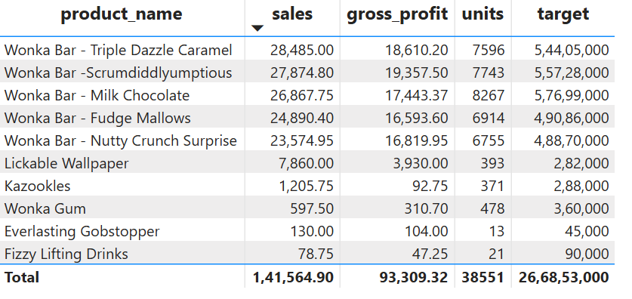
Top 10 Products by Sales
The product sales are highly concentrated in a few key items, particularly the Wonka Bar variants, which dominate the top 5.
Top 5 Products (All Wonka Bars) contribute ~93% of the total sales:
  Wonka Bar - Triple Dazzle Caramel: $28,485
  Wonka Bar - Scrumdiddlyumptious: $27,874.80
  Wonka Bar - Milk Chocolate: $26,867.75
  Wonka Bar - Fudge Mallows: $24,890.40
  Wonka Bar - Nutty Crunch Surprise: $23,574.95
These five alone account for ~74% of gross profit and a major share of units sold (39,988 out of 38,551).
Products like Everlasting Gobstopper and Fizzy Lifting Drinks recorded extremely low sales and contribution.

Slide 8
Implications:
The Wonka Bar line is the clear flagship and should remain a strategic priority for supply chain, marketing, and promotions.
Products with poor sales like Gobstopper or Fizzy Lifting Drinks need a reevaluation – consider:
  Marketing boost
  Product bundling
  Phase-out or reformulation if unviable
The huge gap between actual sales and target values across products (e.g., $28,485 sales vs $5.44 Cr target) suggests unrealistic goals or a major underperformance, warranting further investigation.

Slide 9
Factory-Wise Sales Distribution
Factory Name | Sales
Lot's O' Nuts | 76,340
Wicked Choccy's | 55,352
Secret Factory | 8,587
The Other Factory | 1,282
Sugar Shack | 220.98
Lot's O' Nuts and Wicked Choccy's dominate factory output, accounting for over 90% of total sales among the five.
Sugar Shack, despite having a visible presence, contributed less than $250, signaling:
  Major underutilization
  Operational inefficiency
  Or perhaps it’s not yet fully functional

Slide 10
Action Points:
Focus on scaling Lot's O' Nuts and Wicked Choccy’s, ensuring supply chain stability and reducing bottlenecks.
Conduct an audit of Sugar Shack’s production—if it's operational, it needs urgent intervention.
Re-evaluate Secret Factory and The Other Factory for cost-efficiency or potential repurposing.

Slide 11
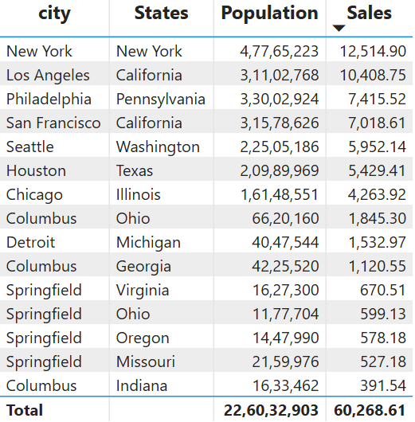
Top 10 Cities by Sales

Slide 12
Insights:
High Sales, High Population:
  New York and Los Angeles lead in absolute sales due to their massive populations and strong market presence.
  However, their per capita sales efficiency is average when normalized by population.
Top Performing by Sales Per Capita:
  Springfield (OH) stands out with $50.89 per 1L population, the highest sales penetration rate.
  Detroit and Springfield (VA) also show high efficiency, despite smaller populations.
California:
  Houses two strong cities—Los Angeles and San Francisco—contributing over $17,000+ together, making California a strategic high-revenue state.
Columbus Confusion:
  There are 3 Columbus cities in Ohio, Georgia, and Indiana.
  Ohio's Columbus is the top contributor among them, suggesting a need to differentiate city identifiers more clearly in data pipelines.

Slide 13
Recommendations:
Invest More in High Penetration Cities: Springfield (OH), Detroit, and Virginia's Springfield show excellent efficiency. They could scale further with more supply and localized campaigns.
Opportunity for Growth: Large cities like Chicago, Houston, and Philadelphia show potential if their per capita reach is improved via targeted marketing.
Clarify Duplicate City Names: Normalize city naming conventions to avoid aggregation errors (e.g., use city_state format).

